Slide 1
Practical Deep Learning 1
Lecture 10

Slide 2
Transfer Learning
Improvement of learning in a new task through the transfer of knowledge from a related task that has already been learned.
We will look at one strategy of transfer learning called Fine-Tuning

Slide 3
When to fine-tune your model?
New dataset is small with distribution similar to original dataset.
Keep the feature extraction part fixed and fine-tune the classifier part of the network
New dataset is large with similar distribution to the original dataset
Fine tune both the feature extractor and the classifier part of the network
New dataset is small but different distribution from the original dataset
Use SVM classifier on the features extracted from the feature extractor part of the Network
New dataset is large and different distribution from the original dataset
Fine tune both the feature extractor and the classifier part of the network

Slide 4
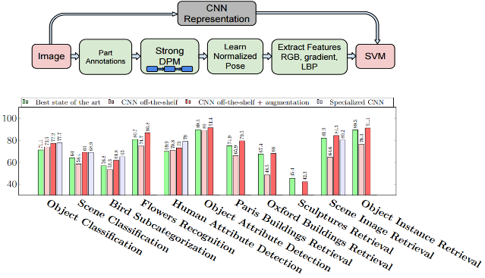
CNN Features off-the-shelf: an Astounding Baseline for Recognition [Razavian et al. 2014]

Slide 5
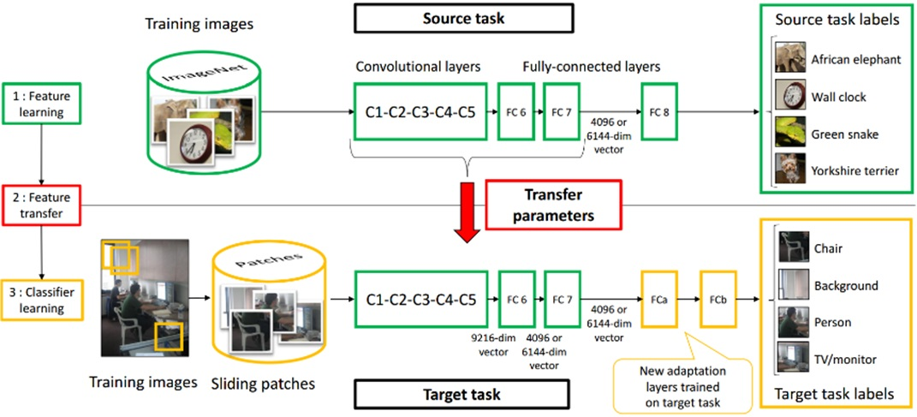
Learning and Transferring Mid-Level Image Representations using Convolutional Neural Networks [Oquab et al. CVPR 2014]

Slide 6
Ensembling
Team-work is the best policy
Multiple networks for the same task
Max Voting for final classification

Slide 7
Ensembling: A simple analysis
Let’s assume that we have a test dataset with N elements and an ensemble of M models.
Also assume that the probability of error of the label for an image on a model in the ensemble is dentoted by p(e) and is i.i.d
For an example assume M=3 and e =0.01
Then probability of error of label for the max voting ensemble will be
For the above example p(e)=0.0003, which is significantly lower than a single model

Slide 8
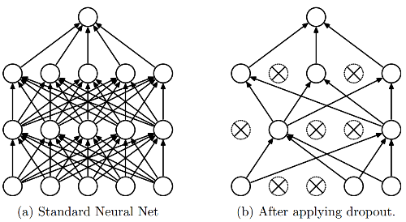
Dropout
Intuition: successful conspiracies
50 people planning a conspiracy
Strategy A: plan a big conspiracy involving 50 people
Likely to fail. 50 people need to play their parts correctly.
Strategy B: plan 10 conspiracies each involving 5 people
Likely to succeed!
Dropout: A simple way to prevent neural networks from overfitting [Srivastava JMLR 2014]

Slide 9
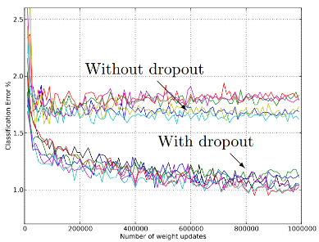
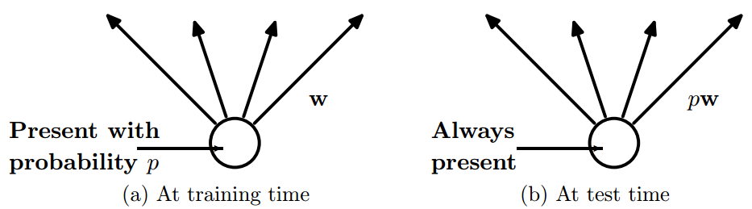
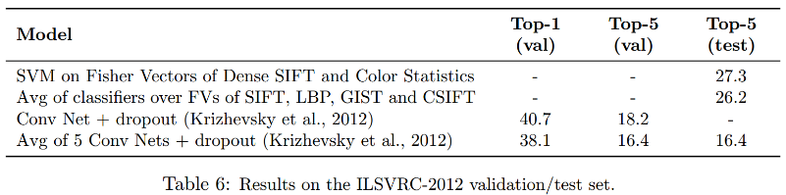
Dropout
Main Idea: approximately combining exponentially many different neural network architectures efficiently
Dropout: A simple way to prevent neural networks from overfitting [Srivastava JMLR 2014]

Slide 10
Batch Normalization
Very useful for training deep networks
Standardizes input of each layer for a mini-batch
Results in speed up of training
For more detail, refer to the paper: Batch Normalization: Accelerating Deep Network Training by Reducing Internal Covariate Shift, 2015

Slide 11
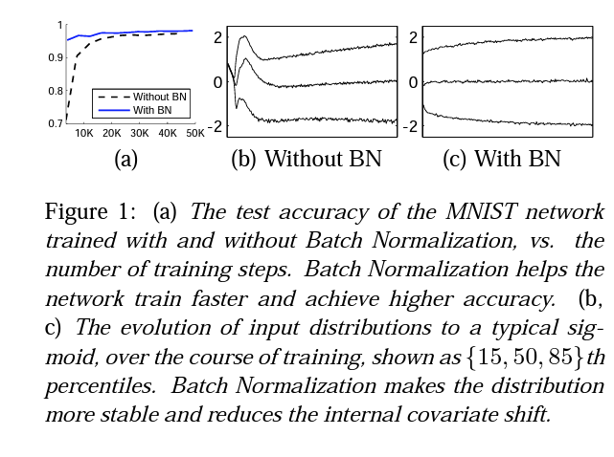
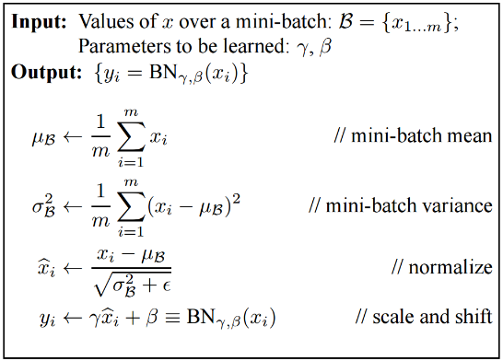
Batch Normalization
Batch Normalization: Accelerating Deep Network Training by Reducing Internal Covariate Shift [Ioffe and Szegedy 2015]

Slide 12
Things to remember
Training Deep Networks Dropout
Data augmentation
Activation
Batch normalization
Transfer learning
Use Fine-tuning when possible

Slide 13
Full Deep learning Pipeline
Data Pre-processing
Architecture
Loss
Optimizer
DataLoaders
Data Augmentation
Fine-Tuning
Ensembling

